Slide 1




FACTOR ANALYSIS
Notes:
You can use this slide as your opening or closing slide. Should you choose to use it as a closing, make sure you review the main points of your presentation. One creative way to do that is by adding animations to the various graphics on a slide. This slide has 4 different graphics, and, when you view the slideshow, you will see that you can click to reveal the next graphic. Similarly, as you review the main topics in your presentation, you may want each point to show up when you are addressing that topic.
Add animation to images and graphics:
Select your image or graphic.
Click on the Animations tab.
Choose from the options. The animation for this slide is “Split”. The drop-down menu in the Animation section gives even more animations you can use.
If you have multiple graphics or images, you will see a number appear next to it that notes the order of the animations.
Note: You will want to choose the animations carefully. You do not want to make your audience dizzy from your presentation.

Slide 2
Factor analysis is a technique that is used to reduce a large number of variables into fewer numbers of factors.
This technique extracts maximum common variance from all variables and puts them into a common score. As an index of all variables, we can use this score for further analysis.
Factor analysis is part of general linear model (GLM) and this method also assumes several assumptions: there is linear relationship, there is no multicollinearity, it includes relevant variables into analysis, and there is true correlation between variables and factors.
Introduction

Slide 3
What is the difference between PCA, FA and LDA?
Principal Component Analysis, Factor Analysis and Linear Discriminant Analysis are all used for feature reduction.
They all depend on using eigenvalues and eigenvectors to rotate and scale the vectors in order to project them to the new dimensions.
They all assume the linearity of the observed data.
Although these three methods have in common that they can reduce dimensionality in your data, they are used in very different cases.

Slide 4
LDA => This method identifies components (i.e., linear combination of the observed variables) that maximize class separation (i.e. between-class variance) when such prior information is available (i.e., supervised). E.g., you have a training set containing a variable specifying the class of each observation.
PCA => Aims to find components that account for maximum variance in the data (including error and within-variable variance). Unlike LDA, it does not take into account class membership (i.e., unsupervised), and is used when such information is not available. Importantly, both LDA and PCA do not require any prior notion of how the variables are related among themselves, and the resulting components cannot be interpreted in terms of an underlying construct.
What is the difference between PCA, FA and LDA?

Slide 5

What is the difference between PCA, FA and LDA?
FA => Tries to uncover latent factors that account for the variance shared between the observed variables (thus excluding error and within-variable variance). Ideally, the resulting latent factors represent interpretable underlying constructs. FA should be used when you assume that an underlying causal model induces covariance between several observed variables. Consequently, unlike PCA and LDA, the observed variables are linear combinations of the estimated latent factors.

Slide 6
PCA vs FA
In principal components analysis, the components are calculated as linear combinations of the original variables. In factor analysis, the original variables are defined as linear combinations of the factors.
In principal components analysis, the goal is to explain as much of the total variance in the variables as possible. The goal in factor analysis is to explain the covariance or correlations between the variables.
In PCA, the components are actual orthogonal linear combinations that maximize the total variance. In FA, the factors are linear combinations that maximize the shared portion of the variance--underlying "latent constructs". That's why FA is often called "common factor analysis".

Slide 7
PCA vs FA
Use principal components analysis to reduce the data into a smaller number of components. Use factor analysis to understand what constructs underlie the data.
The two analyses are often conducted on the same data. For example, you can conduct a principal components analysis to determine the number of factors to extract in a factor analytic study.

Slide 8
Terminologies:
Factor : Linear composite. A way of turning multiple measures into one thing.
Factor Score : Measure of one person’s score on a given factor.
Factor Loadings : Correlation of a factor score with an item. Variables with high loadings are the distinguishing features of the factor.
Communality (h²) : Variance in a given item accounted for by all factors. Sum of squared factor loadings in a row from factor analysis results. These are presented in the diagonal in common factor analysis.

Slide 9

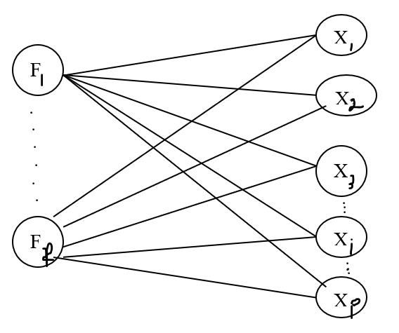
Factor Model:
Suppose we have p variables X1, ….., Xp. The factor model postulates that X is linearly dependent upon a few unobservable random variables F1, F2,…., Fm called common factors, and p additional sources of variations ℇ1, ℇ2 ,…., ℇp called errors.

Slide 10
Factor Model:
The factor model is:
X₁ - μ₁ = l₁₁ F₁ + l₁₂ F₂ + ……+ l_{1m} F_{m} + ℇ₁
X₂ - μ₂ = l₂₁ F₁ + l₂₂ F₂ + ……+ l_{2m} F_{m} + ℇ₂
.
.
.
X_{p} - μ_{p} = l_{p1} F₁ + l_{p2} F₂ + ……+ l_{pm} F_{m} + ℇ_{p}
Where l_{ij} = is the loading of the i^{th} variable on the j^{th} factor. This is an unknown quantity to be estimated. The matrix L is the matrix of factor loadings.
The i^{th} specific vector ε_{i} is associated only with the i^{th} response X_{i}.
The p deviations X₁ - μ₁, X₂ - μ₂, … , X_{p} - μ_{p} are expressed in terms of (p+m) random variables F₁, F₂,…, F_{m}, ℇ₁, ℇ₂,…, ℇ_{p} which are unobservable.

Slide 11
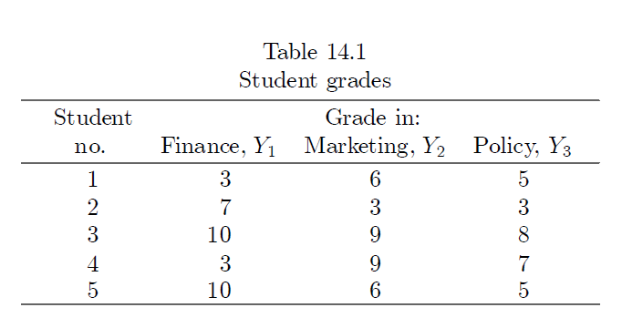
Example:
Factor analysis is best explained in the context of a simple example. Students entering a certain MBA program must take three required courses in finance, marketing and business policy. Let Y1, Y2 and Y3 respectively represents a student’s grades in these courses. The available data consist of the grades of five students.

Slide 12
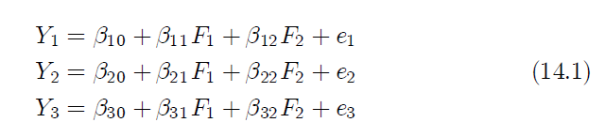
Example:
It has been suggested that these grades are functions of two underlying factors, F1 and F2 tentatively and rather loosely described as quantitative ability and verbal ability respectively. It is assumed that each Y variable is linearly related to the two factors as follows:
The error term e1, e2 and e3 serve to indicate that the hypothesised relationships are not exact.

Slide 13
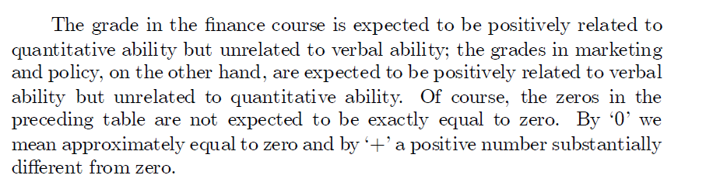
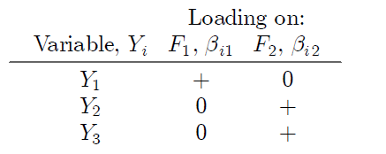
Example:

Slide 14
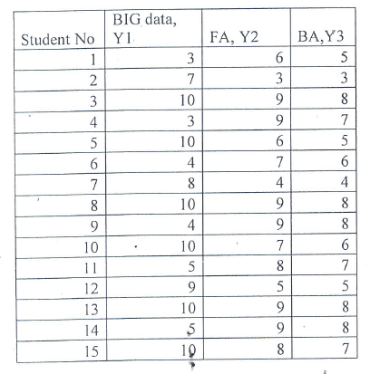
Example:
Students entering a certain MBA tech Business analytics program must take three required courses – BIG Data technology, Financial Analytics and Business Analytics. Let Y1, Y2 and Y3 respectively represent a student’s grades in these courses. The available data consist of the grades of 15 students, we do FA based on these data points.

Slide 15
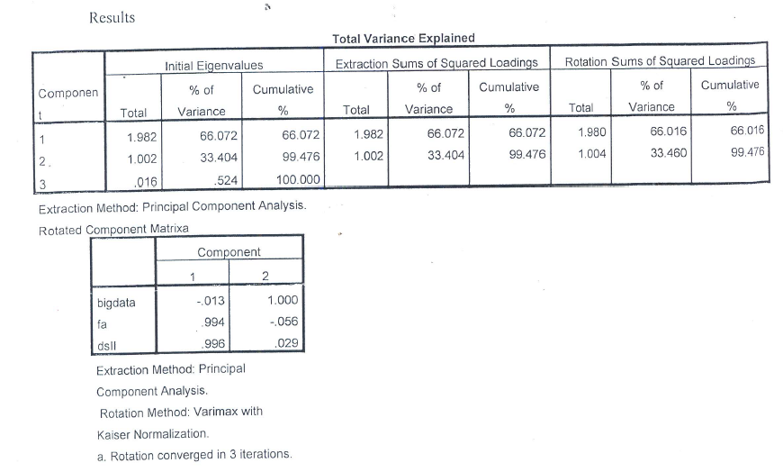
Example:

Slide 16
Example:
Factor – The initial number of factors is the same as the number of variables used in the factor analysis. However, not all 3 factors will be retained. In this example, only the first 2 factors will be retained.
Initial Eigenvalues – Eigenvalues are the variances of the factors. Because we conducted our factor analysis on the correlation matrix, the variables are standardized, which means that the each variable has a variance of 1, and the total variance is equal to the number of variables used in the analysis, in this case,3.
Total – This column contains the eigenvalues. The first factor will always account for the most variance (and hence have the highest eigenvalue), and the next factor will account for as much of the left over variance as it can, and so on. Hence, each successive factor will account for less and less variance.
% of Variance – This column contains the percent of total variance accounted for by each factor.

Slide 17
Example:
Extraction Sums of Squared Loadings – The number of rows in this panel of the table correspond to the number of factors retained. The values in this panel of the table are calculated in the same way as the values in the left panel, except that here the values are based on the common variance. The values in this panel of the table will always be lower than the values in the left panel of the table, because they are based on the common variance, which is always smaller than the total variance.
Cumulative % – This column contains the cumulative percentage of variance accounted for by the current and all preceding factors. For example, the first row shows a value of 66.072. This means that the first factor accounts for 66.072% of the total variance.

Slide 18
Example:
Rotation Sums of Squared Loadings – The values in this panel of the table represent the distribution of the variance after the varimax rotation. Varimax rotation tries to maximize the variance of each of the factors, so the total amount of variance accounted for is redistributed over the three extracted factors.
Rotated Component Matrix:
Factor – The columns under this heading are the rotated factors that have been extracted. As you can see by the footnote provided by SPSS (a.),two factors were extracted . These are the factors that analysts are most interested in and try to name. For example, in the first factor we consider “FA” and “BA” which have high loading which describes the analytical ability of student . The second factor thus contains Big data which describes the technical skills of the student .

